Slide 1
Software Configuration Management
Chapter 25

Slide 2
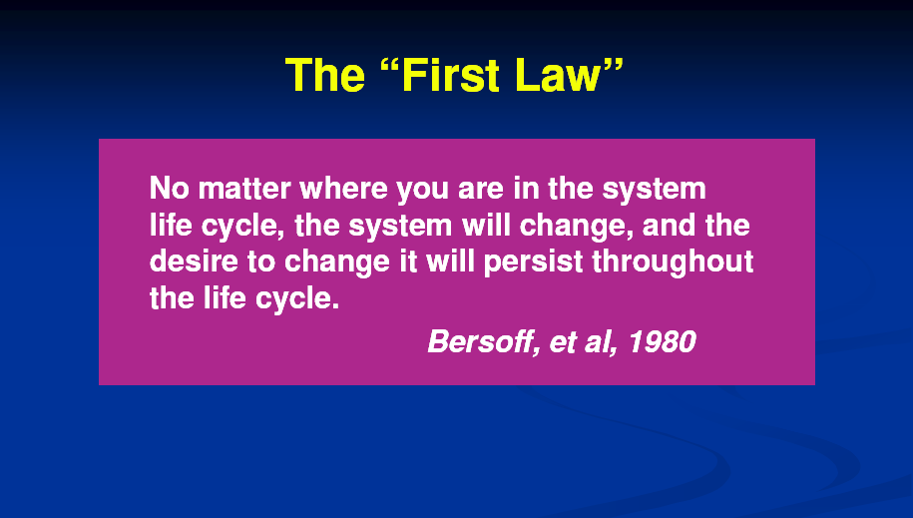

Slide 3
Software Construction
Configuration management (CM) is concerned with the policies, processes, and tools for managing changing software systems. You need to manage evolving systems
It is easy to lose track of what changes and component versions have been incorporated into each system version.
Versions implement proposals for change, corrections of faults, and adaptations for different hardware and operating systems.
Effective configuration management procedures not in place, will waste effort modifying the wrong version of a system, deliver the wrong version of a system to customers, or forget where the software source code for a particular version of the system or component is stored.

Slide 4
Why Configuration Management
Changes in user requirement, policy, budget, schedule need to be accommodated.
Software should able to run on various machines and Operating Systems
Helps to develop coordination among stakeholders
SCM process is also beneficial to control the costs involved in making changes to a system

Slide 5
Problems of Not Using SCM
If you don’t have effective configuration management procedures in place, you may have following issues:
Waste effort modifying the wrong version of a system
Deliver the wrong version of a system to customers,
forget where the software source code for a particular version of the system or component is stored.

Slide 6
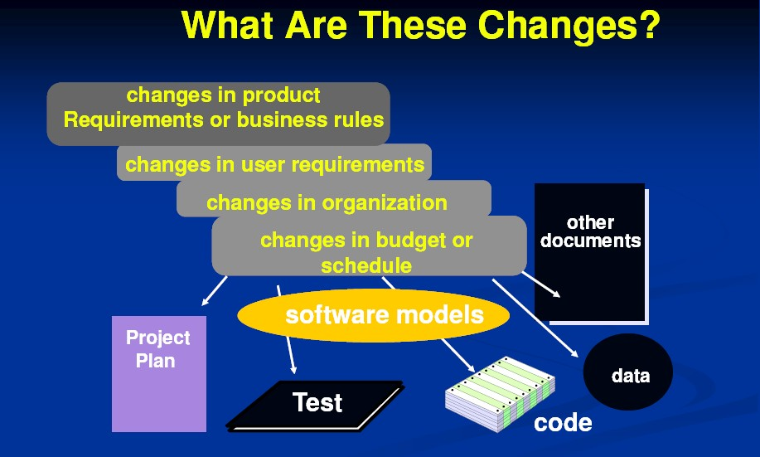
Notes:
Any change to the configuration items will affect the product and hence changes to configuration items needs to be controlled and managed.

Slide 7
What are Software Changes
New business or market conditions
Changes to SW requirements or business rules
New customer needs
demand modification of data, functionality, or services
Business reorganization
causes changes in project priorities or software engineering team structure
Budgetary or scheduling constraints
cause system to be redefined

Slide 8
SCM Activities
The configuration management of a software system product involves four closely related activities
Change management:
This involves keeping track of requests for changes to the software from customers and developers
Working out the costs and impact of making these changes, and deciding if and when the changes should be implemented.

Slide 9
SCM Activities
Version management
This involves keeping track of the multiple versions of system components and ensuring that changes made to components by different developers do not interfere with each other.
System building
This is the process of assembling program components, data, and libraries, and then compiling and linking these to create an executable system.

Slide 10
SCM Activities
Release management
This involves preparing software for external release and keeping track of the system versions that have been released for customer use.

Slide 11
Types of Versions
Baseline versions
Intermediate versions, and
Revisions
They are all quite different and serve different needs.

Slide 12
Baseline
These are the bigges.
Planned early
Reviewed, tested
These are milestone in the software system’s life cycle.
These are the major releases!
Usually have major changes or upgrades or enhancements.

Slide 13
Baseline
A work product becomes a baseline only after it is reviewed and approved.
A baseline is a milestone in software development that is marked by the delivery of one or more configuration items.
Once a baseline is established each change request must be evaluated and verified by a formal or informal procedure before it is processed.

Slide 14
Intermediate
Usually designed to address immediate problems as to correct defects in an important SCI or to include an immediate adaptations for a new customer.
This is an intermediate version of the software.
May be done to serve only a small segment of the firm’s clients; perhaps for a limited period until a new baseline is developed.
Realize that all clients may not be using the same version of software

Slide 15
Revisions
Definition: Adjusted versions of an existing baseline or intermediate version.
Purpose: Focuses on fixing issues, improving performance, or refining details.
Characteristics:
Typically involves minor changes
Addresses bugs, inconsistencies, or inefficiencies.

Slide 16
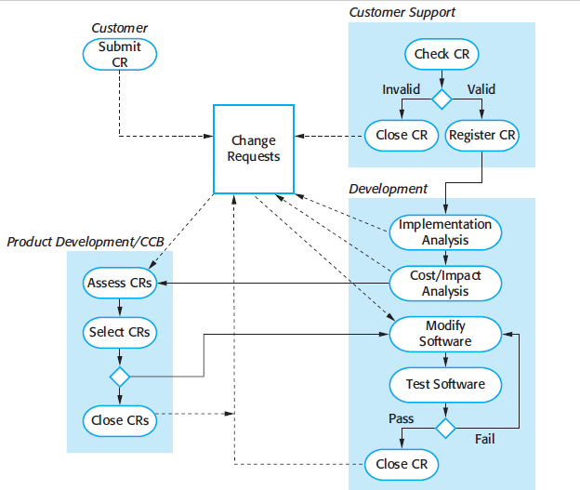
Change Management Process

Slide 17
Codeline and Baseline
A codeline is a sequence of revisions of a configuration item – In essence, a branch
A baseline is a collection of component versions that make up a system.

Slide 18
Configuration Management Activities
Configuration item identification
Promotion management
Release management
Branch management
Variant management
Change management

Slide 19
Configuration Management Activities (continued)
•
Configuration item identification
modeling of the system as a set of evolving components Promotion management
is the creation of versions for other developers Release management
is the creation of versions for the clients and users Change management
is the handling, approval and tracking of change requests Branch management
is the management of concurrent development Variant management
is the management of versions intended to coexist
•
•
•
•
•

Slide 20
Change Management
Change management is the handling of change requests
A change request leads to the creation of a new release
General change process
The change is requested (this can be done by anyone including users and developers)
The change request is assessed against project goals
Following the assessment, the change is accepted or rejected
If it is accepted, the change is assigned to a developer and implemented
The implemented change is audited.

Slide 21
1. Change Request
Specifies the procedures for requesting a change to a baselined CI and the information to be documented:
Name(s) and version(s) of the CI(s) where the problem appears
Originator’s name and address
Date of request
Indication of urgency
The need for the change
Description of the requested change

Slide 22
2. Evaluation of a Change
Specifies the analysis required to determine the impact of proposed changes and the procedure for reviewing the results of the analysis.

Slide 23
3. Change Approval or Disapproval
•
This section of the SCM describes the organization of the configuration control board (CCB).
Configuration Control Board (CCB)
Can be an individual or a group.
Multiple levels of CCBs are also possible, depending on the complexity of the project
Multiple levels of CCBs may be specified.
In small development efforts one CCB level is sufficient.
•
•
•

Slide 24
4. Implementing Change
•
•
This section of the SCMP specifies the activities for verifying and implementing an approved change.
A completed change request must contain the following information:
The original change request(ss)
The names and versions of the affected configuration items
Verification date and responsible party
Identifier of the new version
Archiving completed change requests
Planning and control of releases
How to coordinate multiple changes
How to add new CIs to the configuration
How to deliver a new baseline
•

Slide 25
Change Management
The complexity of the change management process varies with the project.
Small projects can perform change requests informally and fast while complex projects require detailed change request forms and the official approval by one more managers.

